Slide 1

HCI - Assignment n.2
Design and prototyping of an application using a human-centered approach
Deliverable n. 1: Requirement Analysis
Project Title: Cook and Go
Group: 1 - Andreia Portela 97953 LEI, Lucius Vinicius 96123 LEI, Tomé Carvalho 97939 LEI
Lab Class: P4
HCI 2020-2021

Slide 2
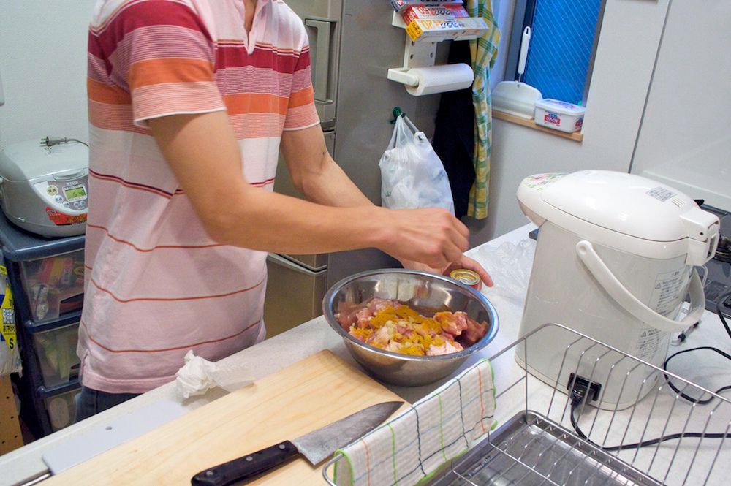
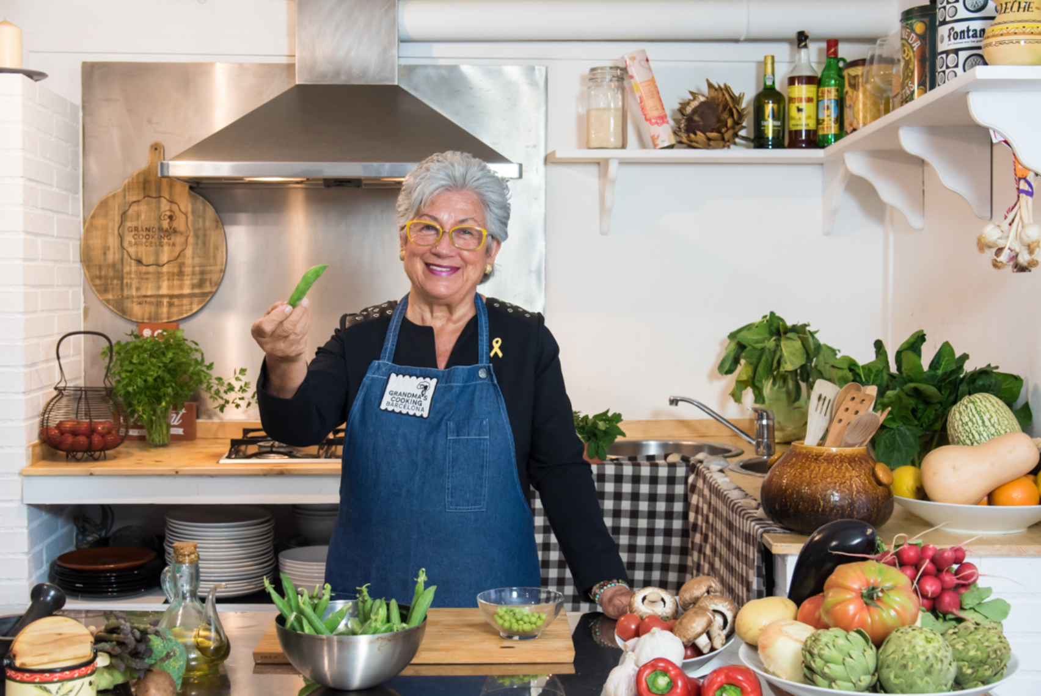
Introduction
Cook and Go
Cooking
Essential activity
Enjoyed by some, despised by others
Requires a good amount of management
Cook and Go: app to help everyone with cooking, from beginners, to experienced cooks
HCI 2020-2021
‹#›

Slide 3
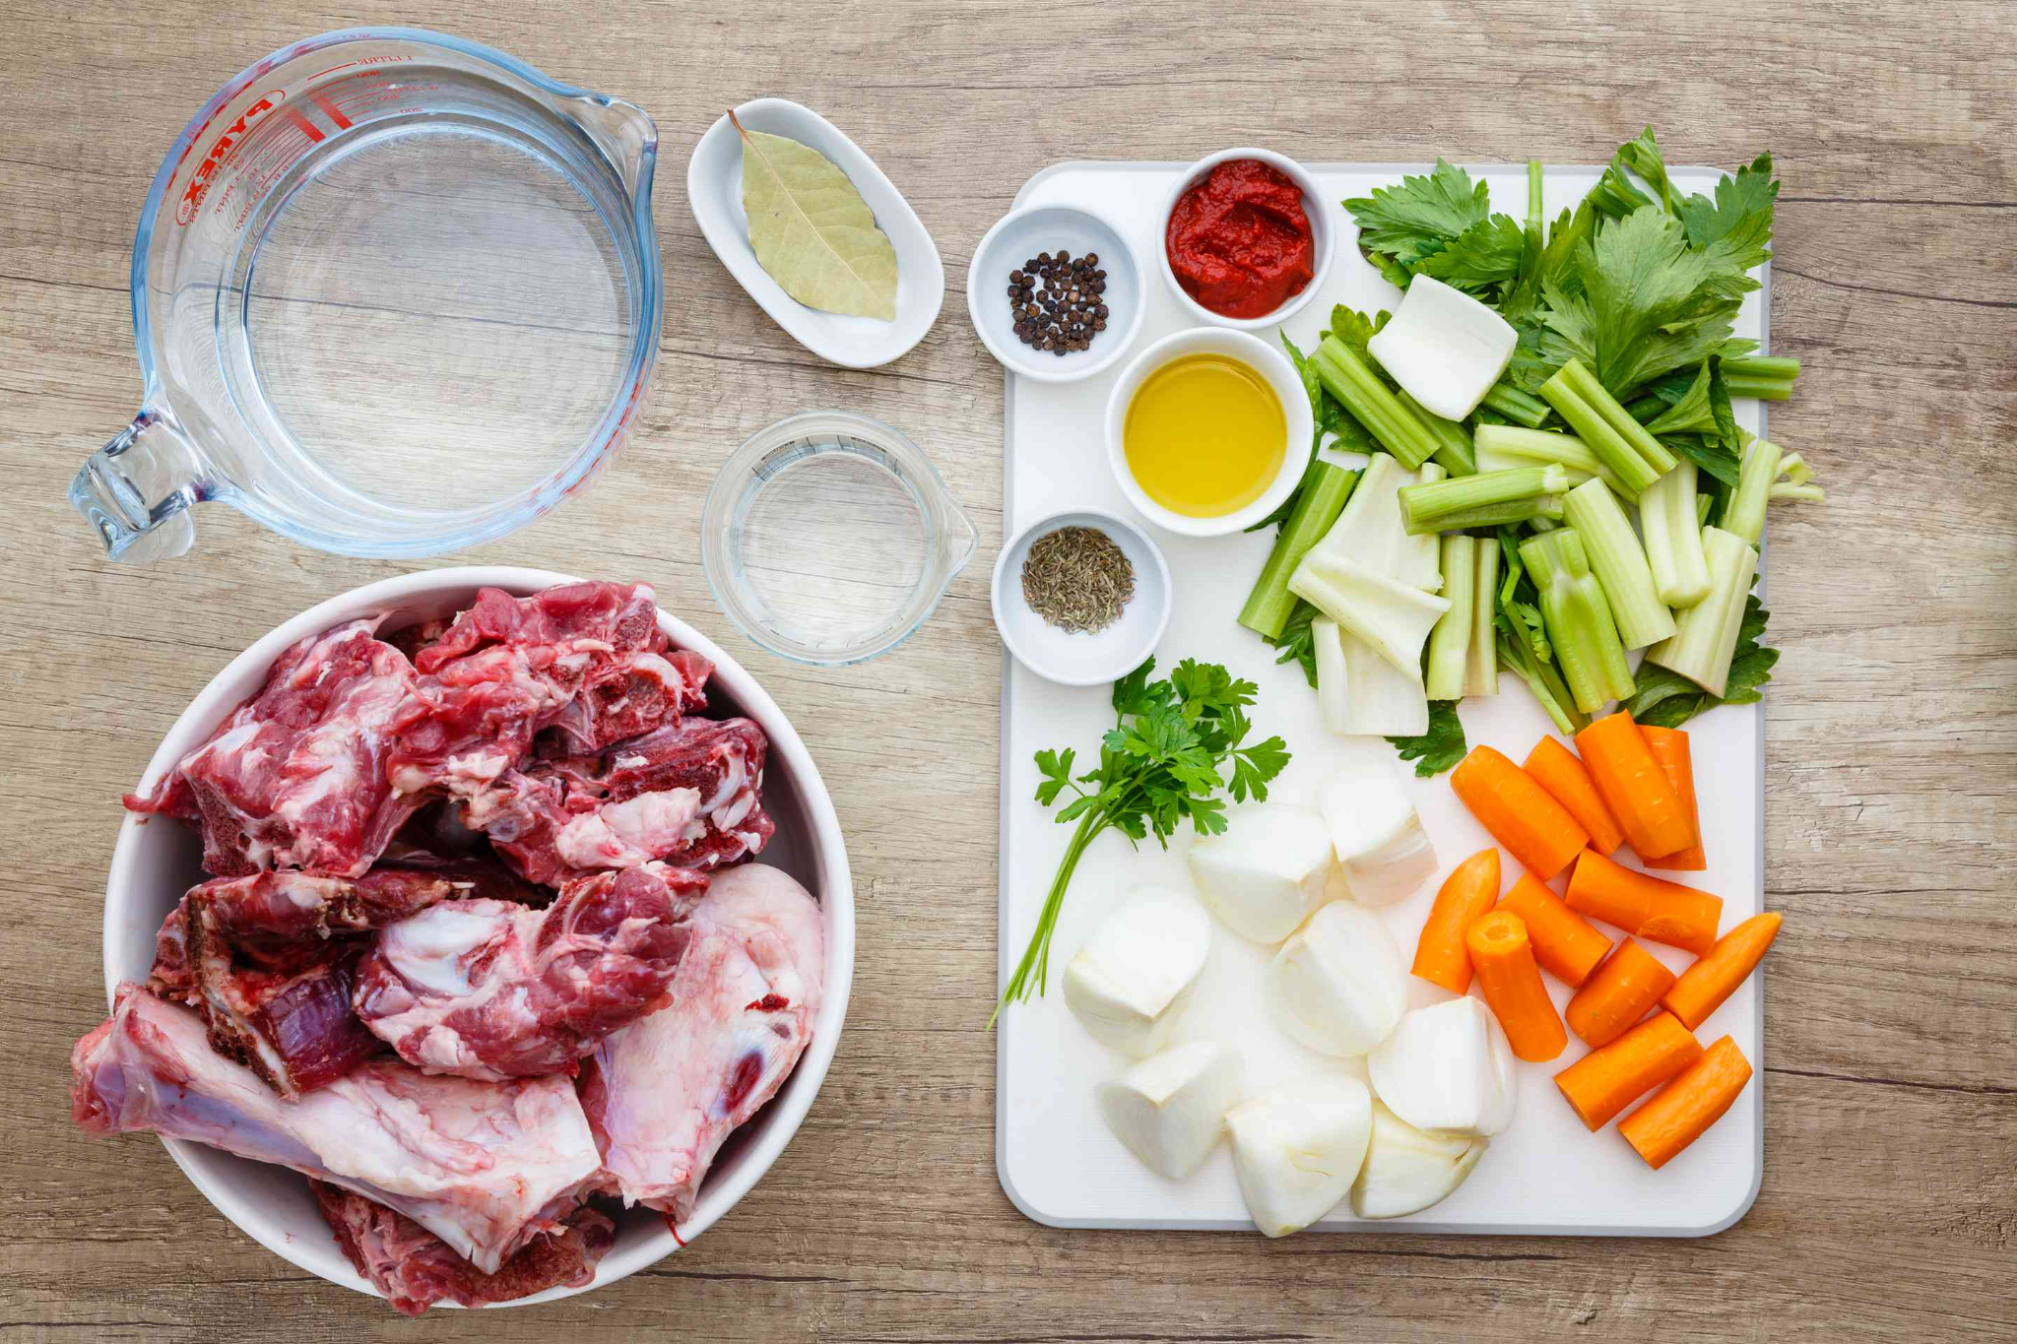
Project Objectives
Cook and Go
Manage ingredients
List recipes
Sort and filter recipes
HCI 2020-2021
‹#›

Slide 4



Personas
Cook and Go
Chad Stevens
Chad is a 20 year old Ohioan who studies at MIT and lives alone. He has neither much cooking experience nor a lot of time to cook, but he also isn’t a big fan of his campus’ canteen. As such, he prefers meals that are easy and quick to cook.
Joaquina Silva Pereira
Joaquina is a 67 year old retired grandmother. She has a 38 year old son, who is the CTO of a tech company. He has two daughters, but due to his busy lifestyle he doesn’t have much time to be with them. Because of this, Joaquina lives with him and the girls and takes care of the girls when their father can’t. She often cooks meals for the 4 of them. She enjoys cooking and has been doing it for a long time. As such, she likes to take some time to prepare harder meals with a lot of ingredients.
HCI 2020-2021
‹#›

Slide 5
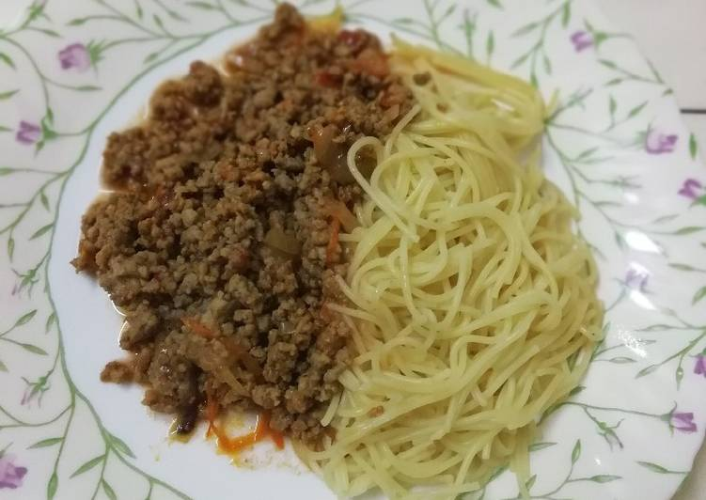
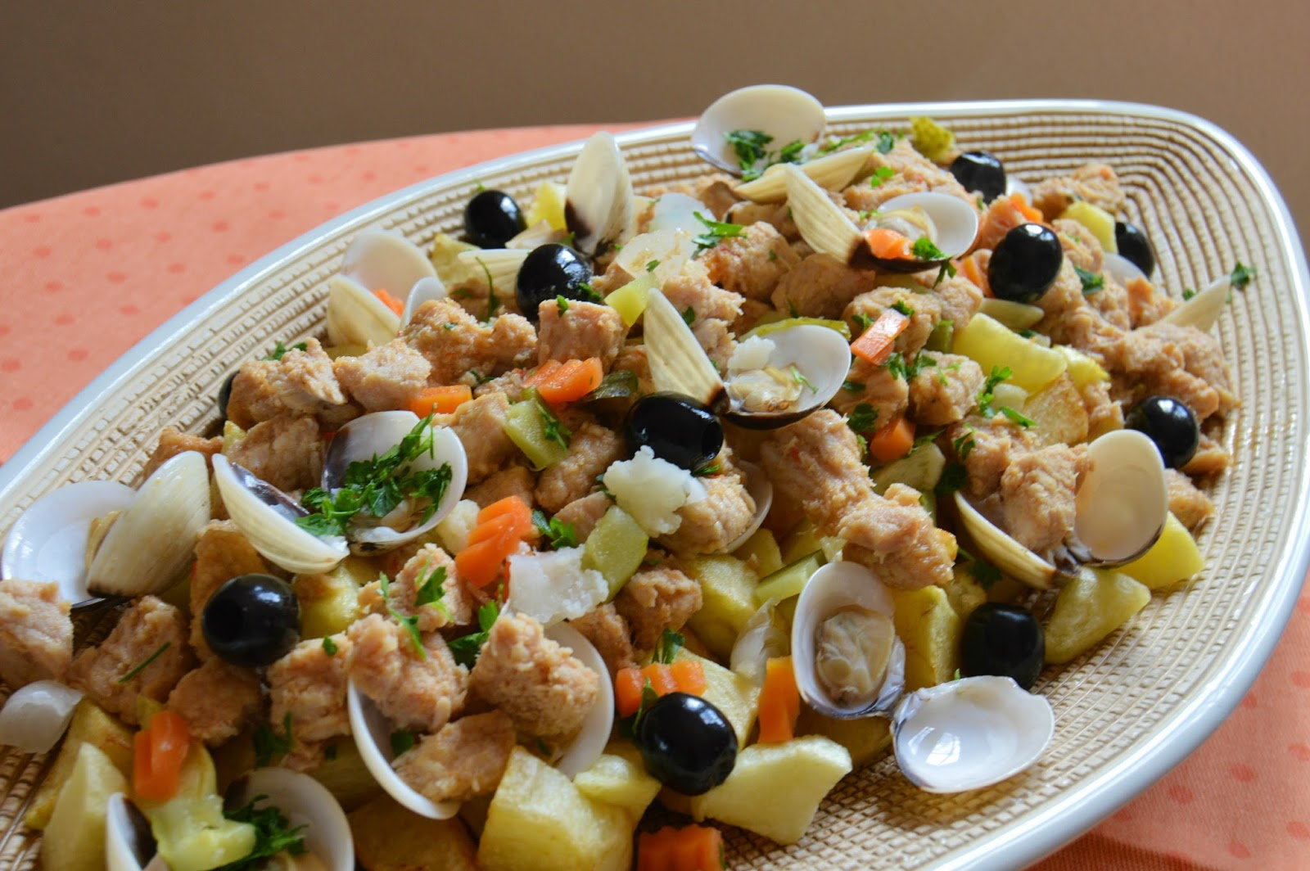
Scenarios
Cook and Go
Chad cooks dinner with whatever is left at home. Having previously registered the ingredients he has in the app, he applies the filter and sorts by prep time. He selects the quickest meal, sets the amount of meals to 1, reads the recipe and starts cooking it.
Joaquina checks the ingredients for 4 meals of “carne de porco à alentejana” to buy what she’s missing for lunch. The app’ll tell her the ingredients that are missing, showing them in red. After purchasing them, she registers the ingredients she bought in the app.
HCI 2020-2021
‹#›

Slide 6
Tasks
Cook and Go
0.
Choose a recipe with available
ingredients
0.
Check ingredients needed for a recipe
1.
Open the recipes book
2.
Sort list by prep time
3.
Choose recipe
1.
Open the recipes book
2.
Search “Carne de Porco à Alentejana”
3.
Choose recipe
4.
Choose quantity: 4
2.1.
Click on sort button
2.2.
Choose prep time
HCI 2020-2021
‹#›

Slide 7

Requirements
Cook and Go
Functional Requirements
Search
Filter
Manage ingredients
Sort by meal attributes
Non-functional requirements
Database
Intuitive and quick to use UI
HCI 2020-2021
‹#›
Notes:
Tomé (último do recap)

Slide 8
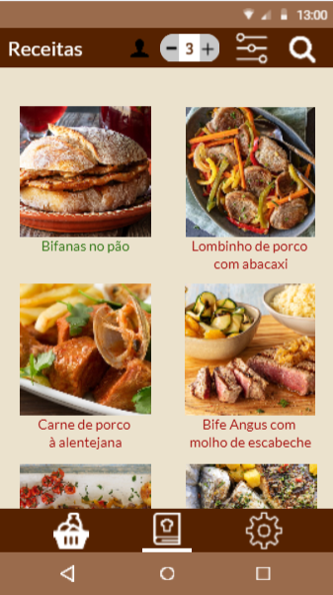
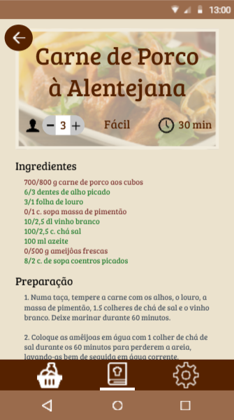
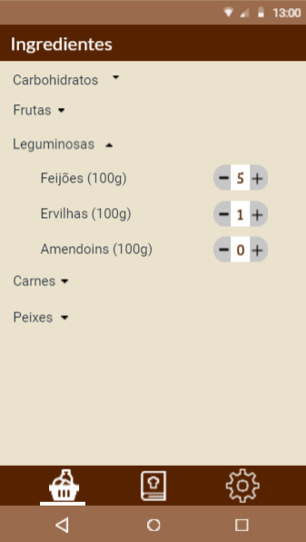
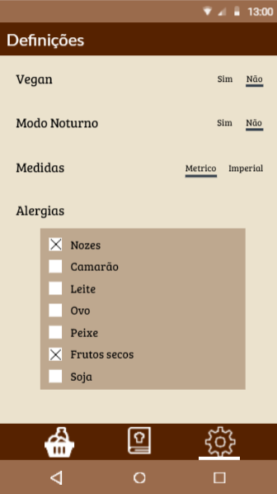

Low Fidelity Prototype (LFP)
Cook and Go
We made a digital prototype.
We asked target users to test our prototype according to our scenarios.
Low Fidelity Prototype
HCI 2020 - 2021
‹#›
Notes:
Cringe Lucius

Slide 9
LFP User Evaluation
Cook and Go
A questionnaire where we asked our target users to accomplish some key tasks.
The app’s features and usability were the main focus.
All the personas and their respective tasks were used in the testing process.
Our 7 participants, 4 female and 3 male, were between 19 and 52 years old
We had to solve two main issues:
Profile button not intuitive (used to be a settings gear)
Lack of saving filter button
Chad Test
1. You only want to see recipes you can cook with the ingredients you have at home.
2. You want to order those recipes by time (ascending).
3. Choose the recipe that is going to take the least time to cook..
4. Make the recipe.
Joaquina Test
1. You want to see what ingredients you are missing to make “carne de porco à Alentejana” for 4 people.
Extra Test
1. Let the app know you are allergic to fish.
HCI 2020 - 2021
‹#›
Notes:
Andreia

Slide 10
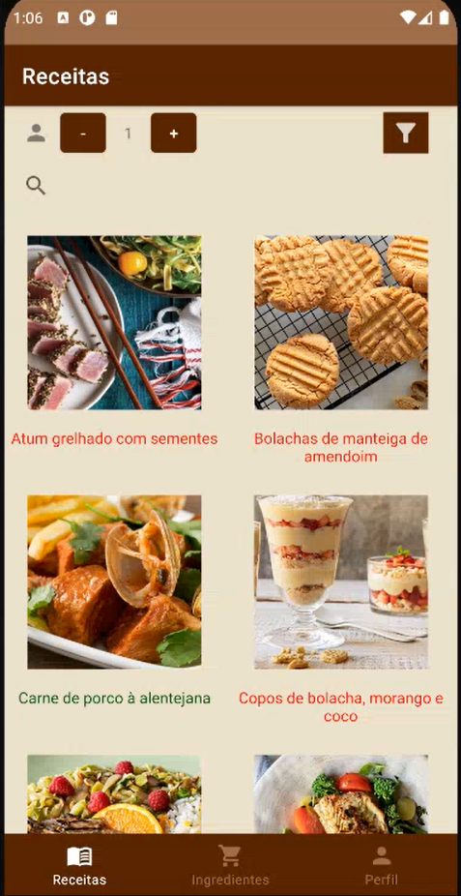
Changes
Cook and Go
Profile button changed to a
standard “profile” button

Slide 11
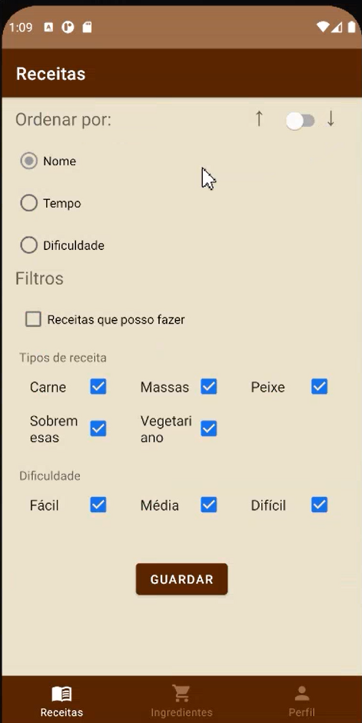
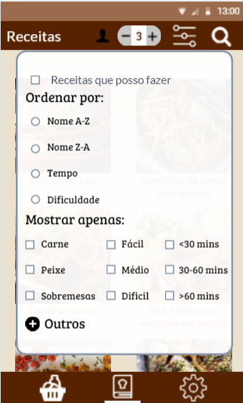
Changes
Cook and Go
Added a saving filter button
(the only way to save before, was to exit the filter page; not intuitive for the participants)

Slide 12



Platform Used for the functional prototype
Cook and Go
Android Studio and its native libraries was the main tool for the application.
We used Java instead of Kotlin, due to our familiarity with the language.
This platform was ideal because it was specifically designed for the development of Android applications, unlike the technologies we had used before.
HCI 2020 - 2021
‹#›
Notes:
Lucius

Slide 13
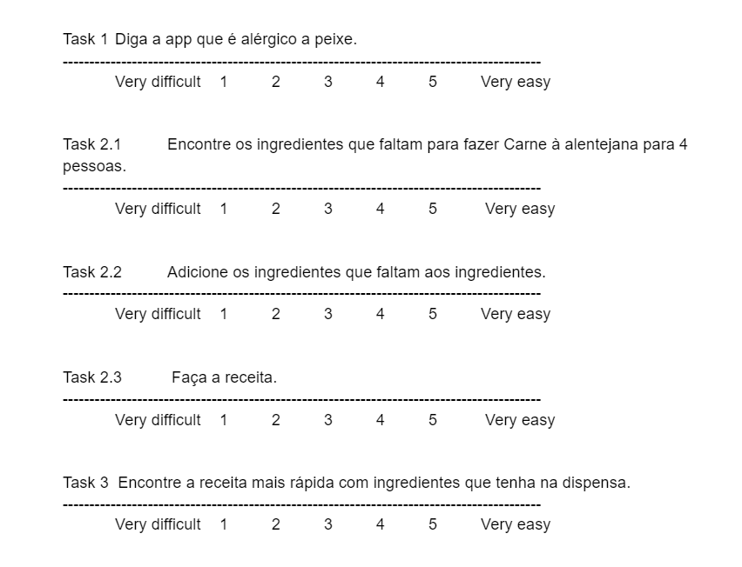
User Evaluation of the functional prototype
Cook and Go
Our goal remained the same. All personas and scenarios and their respective tasks were addressed.
This time we had 5 participants, 2 women and 3 men with ages ranging from 19 to 48.
This time we only had one main issue: we had search by name on the recipes but not on the ingredients.
HCI 2020 - 2021
‹#›
Notes:
Andreia

Slide 14
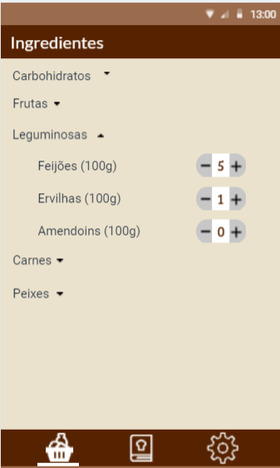
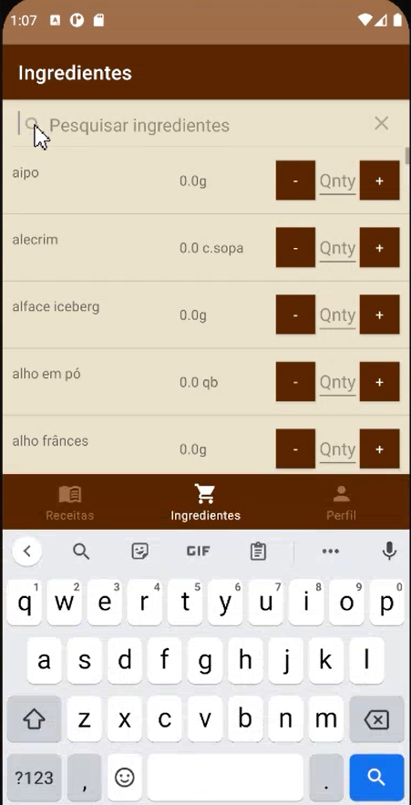
Changes
Cook and Go
Added a “search by name” field on the ingredients page.

Slide 15
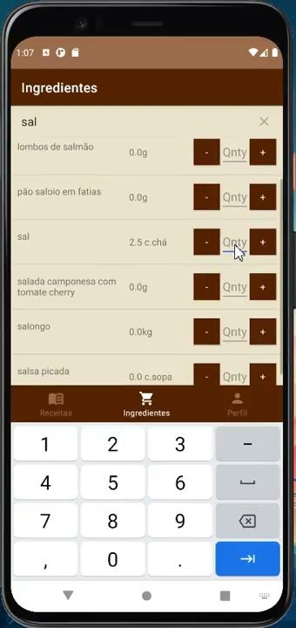
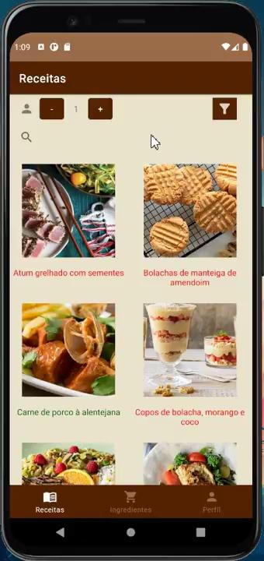
Demo
Cook and Go
Tasks 1 and 2
Task 3
HCI 2020 - 2021
‹#›
Notes:
Tomé

Slide 16
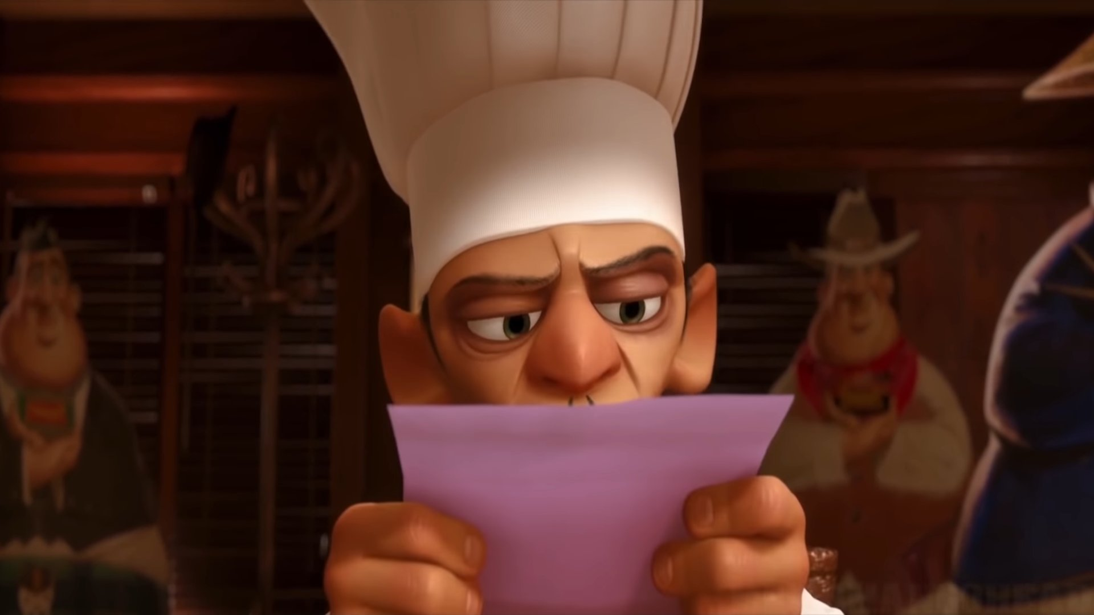
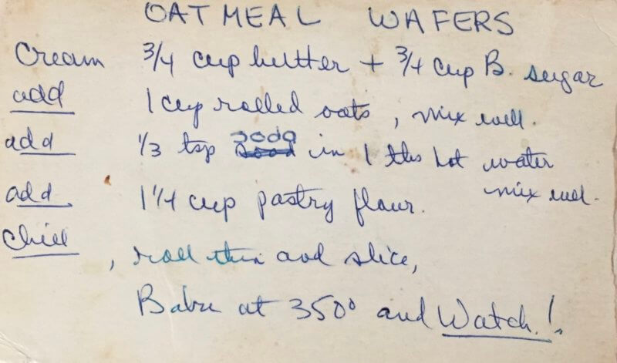
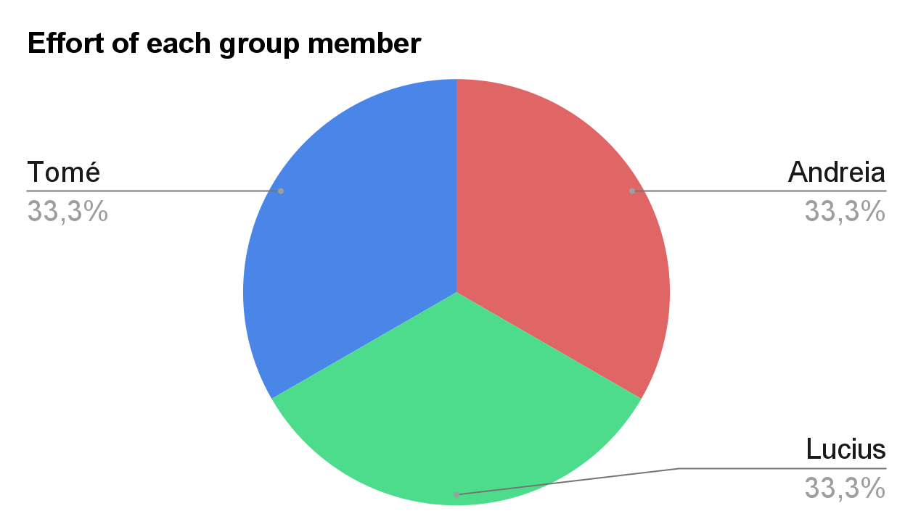

Future Work
Cook and Go
The next step for Cook and Go would be to implement a feature to allow users to add their own recipes and ingredients.
HCI 2020 - 2021
‹#›
Notes:
Lucius

Slide 17


Acknowledgments
Cook and Go
We would like to thank our participants and the teachers who helped us with Android Studio.
(This presentation is based on a template produced by Bernardo Marques)
HCI 2020 - 2021
‹#›
Notes:
Andreia

Slide 18

Questions
Cook and Go
HCI 2020 - 2021
‹#›
Notes:
Andreia

